Slide 1
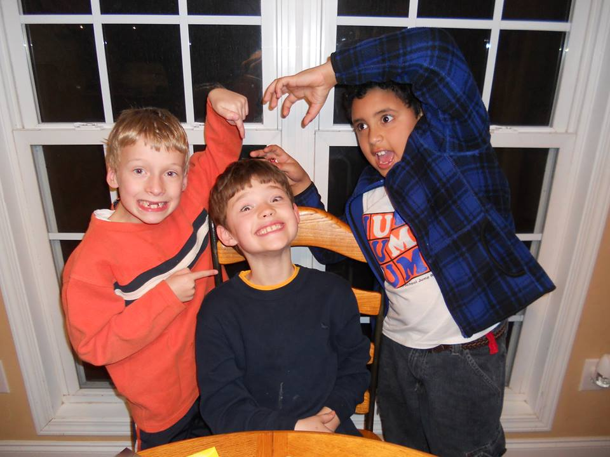
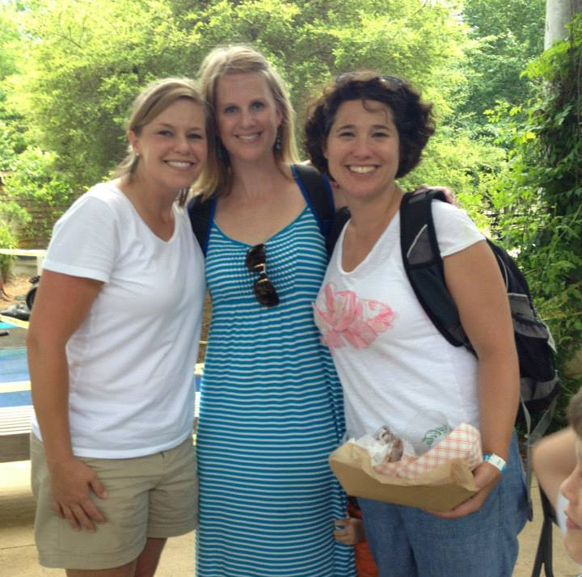
Chapter 10
Friendship in Our Lives

Slide 2
What makes someone a friend?

Slide 3
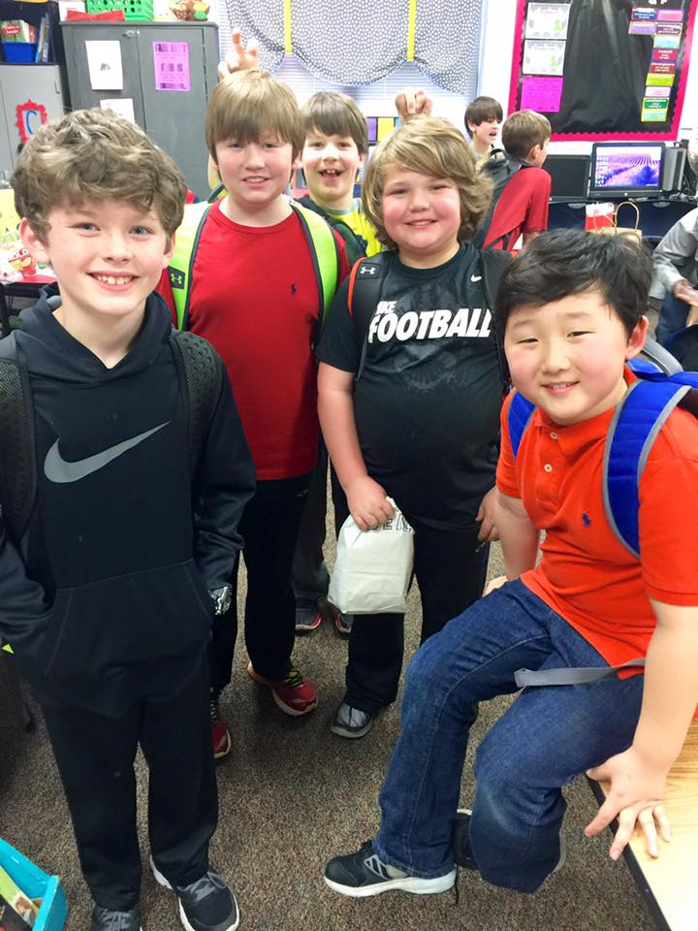
Friendship involves seeing someone as a unique individual.
Friendship is voluntary.
Friendship lacks institutionalized structures and guidelines.

Slide 4
What have your friends done for you?

Slide 5
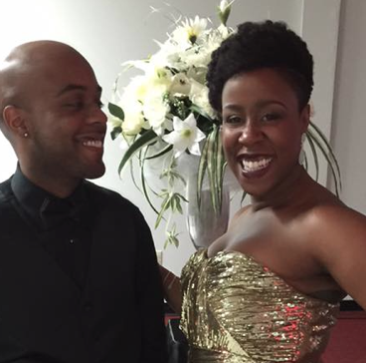
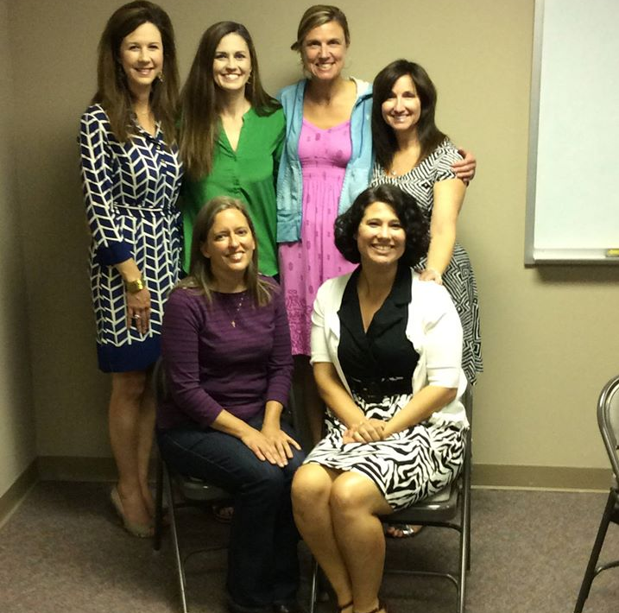
What do friends do for each other?
Instrumental Rewards- Receiving tangible resources
Expressive Rewards- Emotional support

Slide 6
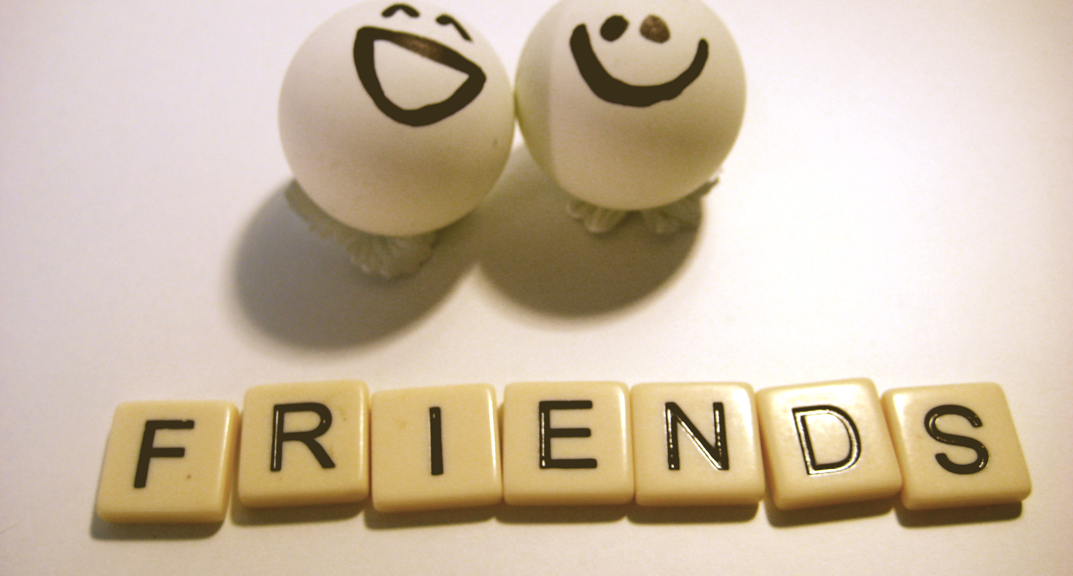
2013 State of Friendship in America Report
Most people are not fully satisfied with the state of their friendships.
People who say they have close friends report more happiness and more fulfillment in life.
Women report more close friends, but are no happier than men.
Social media is insignificant in long-term close friendships.
Individuals who observe weekly religious services, who are ideologically conservative, and reside in an urban center report highest levels of satisfaction.

Slide 7

Decline in Close Friendships
25% of Americans have no close confidants
Average # of close friends has dropped from 4 to 2
Notes:
And yet dependency on family has gone up 57% to 80%.
-American Sociological Review, 2006

Slide 8
What are your expectations of friends?

Slide 9
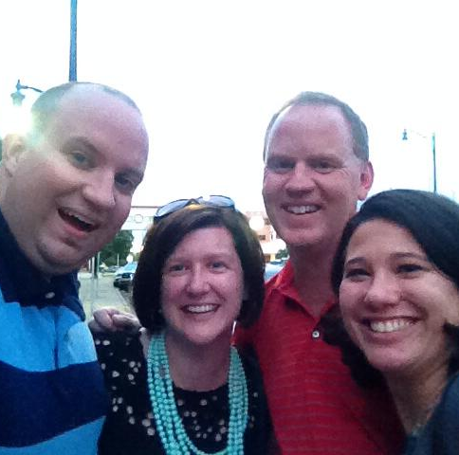
What are our expectations?
Companionship – sharing activities/company
Consideration- helpfulness
Communication- discussing info about one’s self
Affection- expressing sentiments
Notes:
Emotional closeness – women see talking and listening as the main activities that create closeness. Talk is disclosive and emotionally expressive.
Men’s primary is closeness through doing. Talk is less likely to be emotionally disclosive and more likely to negotiate activities.

Slide 10
Dunbar’s Number
Number of people you can have a relationship with involving trust and obligation – there's some personal history, not just names and faces.
A suggested cognitive limit to the number of people with whom one can maintain stable social relationships.
Notes:
Roman’s army limited to 150 units.
Neolythic farming communities would split up once exceeded 150 farmers.
Comunes can stay stable around 150 members.
The larger the number the more difficult it is for individuals to feel connected.

Slide 11
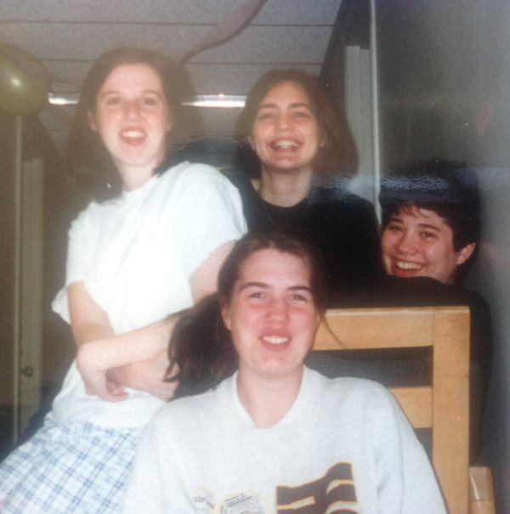
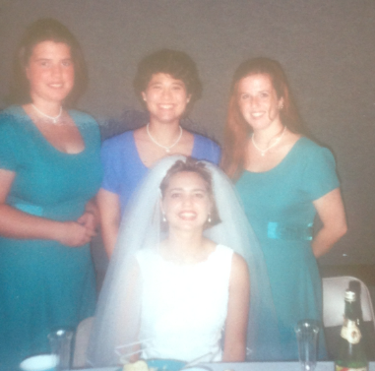
Making Acquaintances
-Initiate conversations
-Develop an other-centered focus
-Engage in turn-taking
-Make comments relevant
-Be polite
The Friend Algorithm

Slide 12
Friendships Across the Life Span
3-6 Momentary physicalistic playmates
6-9 Opportunity and activity
9-12 Consensual validation
Notes:
3-6 friends as long as participating jointly in some shared activity
6-9 feel they should share points of view. Want shared activity and the opportunity to play – next door neighbors
9-12 choose friends whose beliefs agree with their own, increase need for interpersonal closeness.

Slide 13
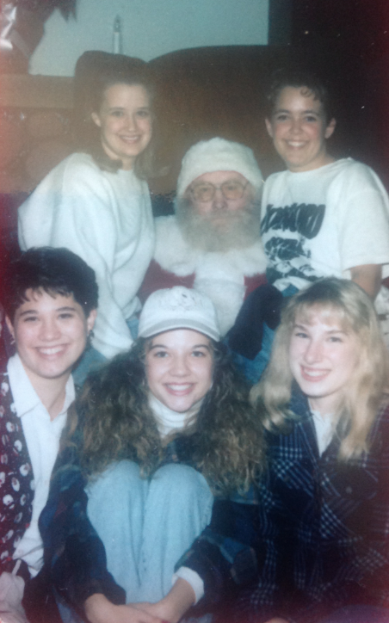
Friendships help adolescence develop a sense of non-judgmental identity.
Notes:
Parents tend to be judgemental.
Majority of friendships are same gender. Cross gender friendships exist, both boys and girls find valuable because they provide valuable info and insights about opposite sex. Important to stress romantic vs platonic relationships.

Slide 14
Young adults report more friendships
Following marriage, friends decrees
Notes:
Furthermore, when people marry, they generally become more dependent on spouses and less so on friends for meeting social needs. Men especially tend to rely on female friends as confidants, but when they marry they find that their wives meet their expressive needs by becoming live-in confidants, that is, "friends."
Also during middle adulthood, men show a drop in the number and intensity of same- as well as cross-gender friendships. This is partly because their preoccupation with career development leaves them little time to cultivate anything but superficial friendships. In addition, men most often meet other men in work settings. Because of this, many of their potential friends are people with whom they compete for raises or advancement, or with whom they are involved either as supervisors or subordinates. Neither of these conditions is conducive to the openness and personalized concern necessary for the development of a close friendship. When friendships do develop between male work associates, they are likely to center around shared activities and camaraderie rather than personal self-disclosure and expressiveness.
For women, the increasing flexibility of middle adulthood continues into older adulthood. Older women are thus able to sustain established friendships and to form new ones as friends die or relocate. Throughout life, women's friendships tend to be more expressive than those of men. In older adulthood, then, women have both the social skills and inclination to continue this pattern. Moreover, women are more likely than men to face the prospect of widowhood and to fill the relationship void by emphasizing their friendships. Whereas widows rely on adult children, especially daughters, for material and practical support, they rely on same aged friends to meet their expressive needs and to maintain their morale.
Because men's friendships are centered mostly around work affiliations and shared activities, when men retire and curtail their activities they often lose their friendships as well. Men are less likely than women to form new friendships to replace the ones they lose. Even so, they retain their primary source of personal and emotional support: their wives. In the relatively rare case where a man outlives his wife, he is likely to remarry rather than seek out new friends. With the loss of friends, however, men do lose the stimulation, fun, and camaraderie that goes along with shared interests and activities. Therefore, men who depart from the average and maintain close same-gender friendships throughout life are likely to lead fuller and more satisfying lives in their older adult years.

Slide 15
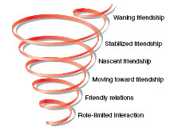
The Development of Friendship
Role-limited interaction
Friendly relations
Moving toward friendship
Nascent friendship
Stabilized friendship
Waning friendship
Notes:
Role-limited- Sit next to the person in class. Work with them. Rely on general scripts.
Friendly relations- What common ground and interests exist?
Moving toward Friendship- moving beyond social roles. Small self-disclosure to indicates we want to personalize the relationship. Want to get coffee? Pleasant but casual friendships.
Nascent- Think of themselves as friends. Share feelings, values, concerns. Work out private rules for interacting. Working out rules.
Stabilized- Assume they’ll continue to see each other. Mutually high level of trust.
Waning- stop investing. Drift apart or pulled in different directions. Most fade slowly

